Slide 1
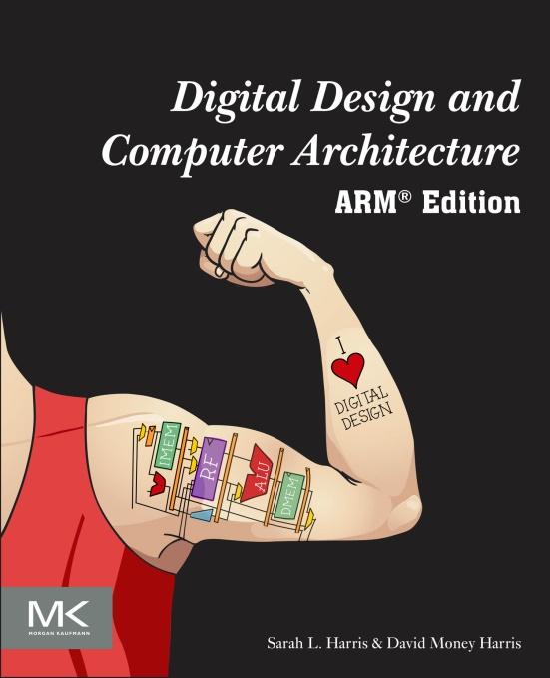
Textbook
Digital Design and Computer Architecture:
ARM® Edition
Sarah L. Harris and David Money Harris, © 2015, Elsevier

Slide 2
Chapter 1
Digital Design and Computer Architecture: ARM® Edition
Sarah L. Harris and David Money Harris

Slide 3
Chapter 1 :: Topics
Background
The Game Plan
The Art of Managing Complexity
The Digital Abstraction
Number Systems
Logic Gates
Logic Levels
CMOS Transistors
Power Consumption

Slide 4
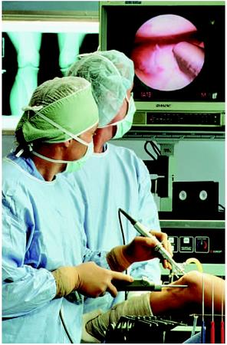

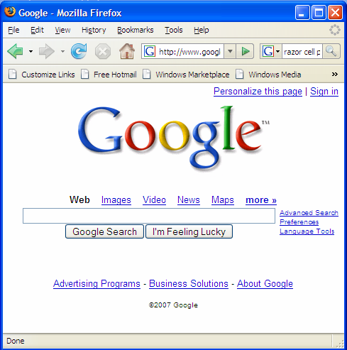
Background
Microprocessors have revolutionized our world
Cell phones, Internet, rapid advances in medicine, etc.
The semiconductor industry has grown from $21 billion in 1985 to $306 billion in 2015.

Slide 5
The Game Plan
Purpose of course:
Understand what’s under the hood of a computer
Learn the principles of digital design
Learn to systematically debug increasingly complex designs
Design and build a microprocessor

Slide 6
The Art of Managing Complexity
Abstraction
Discipline
The Three –y’s
Hierarchy
Modularity
Regularity

Slide 7
Abstraction
Hiding details when they aren’t important
Increasing Abstraction

Slide 8
Discipline
Intentionally restrict design choices
Example: Digital discipline
Discrete voltages instead of continuous
Simpler to design than analog circuits – can build more sophisticated systems
Digital systems replacing analog predecessors: i.e., digital cameras, digital television, cell phones, CDs

Slide 9
The Three -y’s
Hierarchy
Modularity
Regularity

Slide 10
The Three -y’s
Hierarchy
A system divided into modules and submodules
Modularity
Having well-defined functions and interfaces
Regularity
Encouraging uniformity, so modules can be easily reused

Slide 11
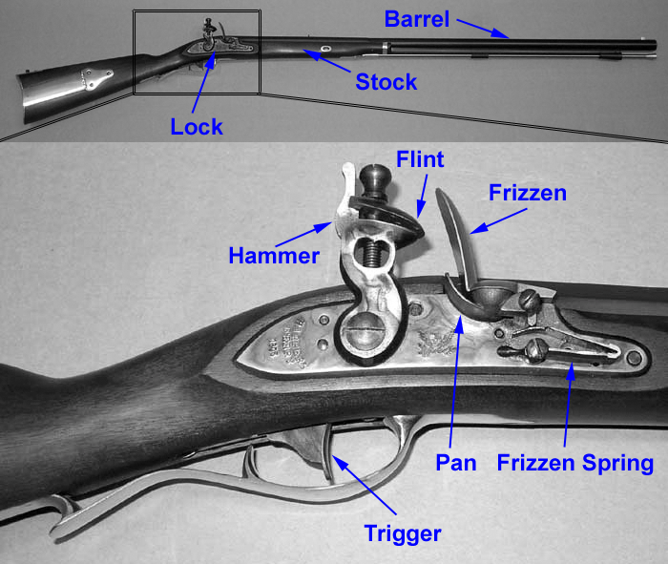
Example: The Flintlock Rifle
Hierarchy
Three main modules: lock, stock, and barrel
Submodules of lock: hammer, flint, frizzen, etc.

Slide 12
Example: The Flintlock Rifle
Modularity
Function of stock: mount barrel and lock
Interface of stock: length and location of mounting pins
Regularity
Interchangeable parts

Slide 13
The Digital Abstraction
Most physical variables are continuous
Voltage on a wire
Frequency of an oscillation
Position of a mass
Digital abstraction considers discrete subset of values

Slide 14
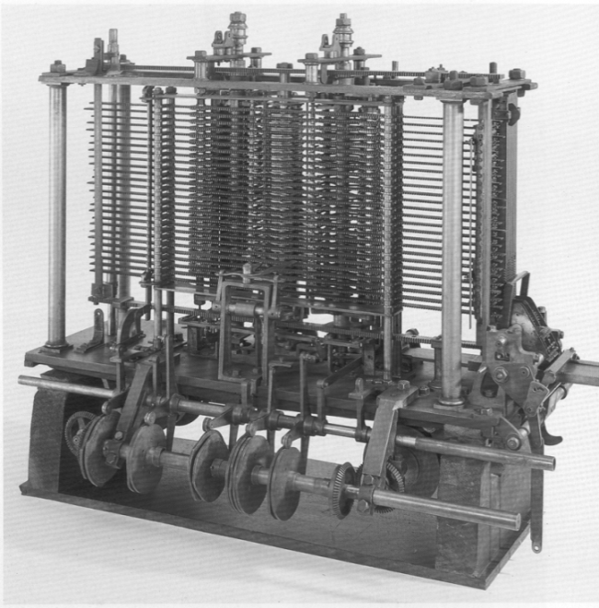
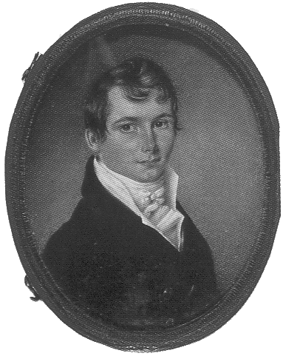
The Analytical Engine
Designed by Charles Babbage from 1834 – 1871
Considered to be the first digital computer
Built from mechanical gears, where each gear represented a discrete value (0-9)
Babbage died before it was finished

Slide 15
Digital Discipline: Binary Values
Two discrete values:
1 and 0

Slide 16
Digital Discipline: Binary Values
Two discrete values:
1 and 0
1, TRUE, HIGH
0, FALSE, LOW
How to represent 1 and 0?

Slide 17
Digital Discipline: Binary Values
Two discrete values:
1 and 0
1, TRUE, HIGH
0, FALSE, LOW
How to represent 1 and 0? voltage levels, rotating gears, fluid levels, etc.
Digital circuits use voltage levels to represent 1 and 0
Bit: Binary digit

Slide 18
Why Digital Systems?

Slide 19
Why Digital Systems?
Easier to design
Fast
Can overcome noise
Error detection/correction

Slide 20
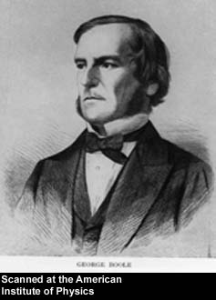
George Boole, 1815-1864
Born to working class parents
Taught himself mathematics and joined the faculty of Queen’s College in Ireland
Wrote An Investigation of the Laws of Thought (1854)
Introduced binary variables
Introduced the three fundamental logic operations: AND, OR, and NOT

Slide 21
George Boole, 1815-1864
Born to working class parents
Taught himself mathematics and joined the faculty of Queen’s College in Ireland
Wrote An Investigation of the Laws of Thought (1854)
Introduced binary variables
Introduced the three fundamental logic operations: AND, OR, and NOT

Slide 22
Number Systems
Decimal
Base 10
Binary
Base 2
Hexadecimal
Base 16

Slide 23
Decimal Numbers
Base 10 (our everyday number system)
Base 10

Slide 24
Decimal Numbers
Base 10 (our everyday number system)
Base 10

Slide 25
Decimal and Binary Numbers
Base 10 (our everyday number system)
Base 2: Binary numbers
Base 2

Slide 26
Decimal and Binary Numbers
Base 10 (our everyday number system)
Base 2: Binary numbers
Base 2

Slide 27
Powers of Two
2⁰ =
2¹ =
2² =
2³ =
2⁴ =
2⁵ =
2⁶ =
2⁷ =
2⁸ =
2⁹ =
2¹⁰ =
2¹¹ =
2¹² =
2¹³ =
2¹⁴ =
2¹⁵ =

Slide 28
Powers of Two
2⁰ = 1
2¹ = 2
2² = 4
2³ = 8
2⁴ = 16
2⁵ = 32
2⁶ = 64
2⁷ = 128
2⁸ = 256
2⁹ = 512
2¹⁰ = 1024
2¹¹ = 2048
2¹² = 4096
2¹³ = 8192
2¹⁴ = 16384
2¹⁵ = 32768
Handy to memorize up to 2⁹

Slide 29
Number Conversion
Binary to decimal conversion:
Convert 10011₂ to decimal
Decimal to binary conversion:
Convert 47₁₀ to binary

Slide 30
Number Conversion
Binary to decimal conversion:
Convert 10011₂ to decimal
16×1 + 8×0 + 4×0 + 2×1 + 1×1 = 19₁₀
Decimal to binary conversion:
Convert 47₁₀ to binary
32×1 + 16×0 + 8×1 + 4×1 + 2×1 + 1×1 = 101111₂

Slide 31
Decimal to Binary Conversion
Two methods:
Method 1: Find the largest power of 2 that fits, subtract and repeat. (Recommended method)
Method 2: Repeatedly divide by 2, remainder goes in next most significant bit

Slide 32
Decimal to Binary Conversion
Method 1: Find the largest power of 2 that fits, subtract and repeat.
53₁₀
Method 2: Repeatedly divide by 2, remainder goes in next most significant bit.
53₁₀

Slide 33
Decimal to Binary Conversion
Method 1: Find the largest power of 2 that fits, subtract and repeat.
53₁₀ 32×1
53-32 = 21 16×1
21-16 = 5 4×1
5-4 = 1 1×1 = 110101₂
Method 2: Repeatedly divide by 2, remainder goes in next most significant bit.
53₁₀ = 53/2 = 26 R1
26/2 = 13 R0
13/2 = 6 R1
6/2 = 3 R0
3/2 = 1 R1
1/2 = 0 R1 = 110101₂

Slide 34
Decimal to Binary Conversion
Another example: Convert 75₁₀ to binary.

Slide 35
Decimal to Binary Conversion
Another example: Convert 75₁₀ to binary.
75₁₀= 64 + 8 + 2 + 1 = 1001011₂

Slide 36
Decimal to Binary Conversion
Another example: Convert 75₁₀ to binary.
75₁₀= 64 + 8 + 2 + 1 = 1001011₂
or
75/2 = 37 R1
37/2 = 18 R1
18/2 = 9 R0
9/2 = 4 R1
4/2 = 2 R0
2/2 = 1 R0
1/2 = 0 R1

Slide 37
Number Conversion
Binary to decimal conversion:
Convert 11101₂ to decimal
16×1 + 8×1 + 4×1 + 2×0 + 1×1 = 29₁₀
Decimal to binary conversion:
Convert 47₁₀ to binary
32×1 + 16×0 + 8×1 + 4×1 + 2×1 + 1×1 = 101111₂

Slide 38
Binary Values and Range
N-digit decimal number
How many values?
Range?
Example: 3-digit decimal number:
N-bit binary number
How many values?
Range:
Example: 3-digit binary number:

Slide 39
Binary Values and Range
N-digit decimal number
How many values? 10^{N}
Range? [0, 10^{N} - 1]
Example: 3-digit decimal number:
10³ = 1000 possible values
Range: [0, 999]
N-bit binary number
How many values? 2^{N}
Range: [0, 2^{N} - 1]
Example: 3-digit binary number:
2³ = 8 possible values
Range: [0, 7] = [000₂ to 111₂]

Slide 40
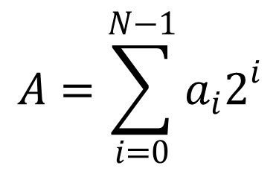
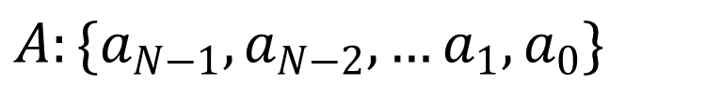
Binary Numbers
$A:\{a_{N−1},a_{N−2},…a_{1},a_{0}\}$
Example:
1101₂ = 1 × 2³ + 1 × 2² + 0 × 2¹ + 1 × 2⁰
= 8 + 4 + 0 + 1
= 13
$$A=\sum_{i=0}^{N−1}{a_{i}2^{i}}$$

Slide 41
Hexadecimal Numbers
Hex Digit | Decimal Equivalent | Binary Equivalent
0 | 0
1 | 1
2 | 2
3 | 3
4 | 4
5 | 5
6 | 6
7 | 7
8 | 8
9 | 9
A | 10
B | 11
C | 12
D | 13
E | 14
F | 15

Slide 42
Hexadecimal Numbers
Hex Digit | Decimal Equivalent | Binary Equivalent
0 | 0 | 0000
1 | 1 | 0001
2 | 2 | 0010
3 | 3 | 0011
4 | 4 | 0100
5 | 5 | 0101
6 | 6 | 0110
7 | 7 | 0111
8 | 8 | 1000
9 | 9 | 1001
A | 10 | 1010
B | 11 | 1011
C | 12 | 1100
D | 13 | 1101
E | 14 | 1110
F | 15 | 1111

Slide 43
Hexadecimal Numbers
Base 16
Shorthand for binary

Slide 44
Hexadecimal to Binary Conversion
Hexadecimal to binary conversion:
Convert 4AF₁₆ (also written 0x4AF) to binary
Hexadecimal to decimal conversion:
Convert 4AF₁₆ to decimal

Slide 45
Hexadecimal to Binary Conversion
Hexadecimal to binary conversion:
Convert 4AF₁₆ (also written 0x4AF) to binary
0100 1010 1111₂
Hexadecimal to decimal conversion:
Convert 4AF₁₆ to decimal
4 × 16² + A × 16¹ + F × 16⁰
4 × 16² + 10 × 16¹ + 15 × 16⁰ = 1199₁₀

Slide 46
Bits, Bytes, Nibbles…
Bits
msb: most significant bit
lsb: least significant bit
Bytes & Nibbles
Bytes
MSB: most significant byte
LSB: least significant byte

Slide 47
Bits, Bytes, Nibbles…
Bits
msb: most significant bit
lsb: least significant bit
Bytes & Nibbles
Bytes
MSB: most significant byte
LSB: least significant byte
Each hex digit represents
a nibble (4 bits)

Slide 48
Large Powers of Two
2¹⁰ = 1 kilo ≈ thousand (1024)
2²⁰ = 1 mega ≈ million (1,048,576)
2³⁰ = 1 giga ≈ billion (1,073,741,824)
2⁴⁰ = 1 tera ≈ trillion (1,099,511,627,776)
2⁵⁰ = 1 peta ≈ 10¹⁵
2⁶⁰ = 1 exa ≈ 10¹⁸

Slide 49
Large Powers of Two
2¹⁰ = 1 kilo (kibi) ≈ 10³ (1024)
2²⁰ = 1 mega (mebi) ≈ 10⁶ (1,048,576)
2³⁰ = 1 giga (gibi) ≈ 10⁹ (1,073,741,824)
2⁴⁰ = 1 tera (tebi) ≈ 10¹²
2⁵⁰ = 1 peta (pebi) ≈ 10¹⁵
2⁶⁰ = 1 exa (exbi) ≈ 10¹⁸

Slide 50
Large Powers of Two
2¹⁰ = 1 kilo ≈ 1000 (1024)
kibibyte = 1 Ki
for example: 1 KiB = 1024 Bytes
1 Kib = 1024 bits
2²⁰ = 1 mega ≈ 1 million (1,048,576)
mebibyte = 1 Mi
for example: 1 MiB, 1 Mib (1 megabit)
2³⁰ = 1 giga ≈ 1 billion (1,073,741,824)
gibibyte = 1 Gi
for example: 1 GiB, 1 Gib

Slide 51
Estimating Powers of Two
What is the approximate value of 2²⁴?
Approximately how many values can a 32-bit variable represent?

Slide 52
Estimating Powers of Two
What is the approximate value of 2²⁴?
2⁴ × 2²⁰ ≈ 16 million
Approximately how many values can a 32-bit variable represent?
2² × 2³⁰ ≈ 4 billion
First factor out the largest 2^{10x}. Then estimate.

Slide 53
Addition
Decimal
Binary

Slide 54
Addition
Decimal
Binary

Slide 55
Binary Addition Examples
Add the following 4-bit binary numbers
Add the following 4-bit binary numbers

Slide 56
Binary Addition Examples
Add the following 4-bit binary numbers
Add the following 4-bit binary numbers

Slide 57
Binary Addition: Numbers of Bits
The addition of two 4-bit values (inputs) gives a 4-bit result (output).
Any additional bits on the left are ignored (overflow!)
Generally, addition of two n-bit numbers gives an n-bit result.
Overflow!

Slide 58
Overflow
Digital systems operate on a fixed number of bits
Overflow: when the result is too big to fit in the available number of bits
See previous example of 11 + 6
Overflow!

Slide 59
Signed Binary Numbers
Sign/Magnitude Numbers
Two’s Complement Numbers

Slide 60
Sign/Magnitude Numbers
1 sign bit, N-1 magnitude bits
Sign bit is the most significant (left-most) bit
Positive number: sign bit = 0
Negative number: sign bit = 1
Example, 4-bit sign/mag representations of ± 6:
+6 =
- 6 =
Range of an N-bit sign/magnitude number:

Slide 61
Sign/Magnitude Numbers
1 sign bit, N-1 magnitude bits
Sign bit is the most significant (left-most) bit
Positive number: sign bit = 0
Negative number: sign bit = 1
Example, 4-bit sign/mag representations of ± 6:
+6 = 0110
- 6 = 1110
Range of an N-bit sign/magnitude number:
[-(2^{N-1}-1), 2^{N-1}-1]

Slide 62
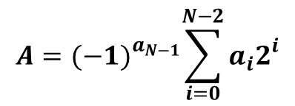
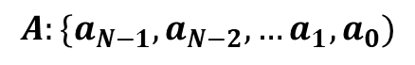
Sign/Magnitude Numbers
1 sign bit, N-1 magnitude bits
Sign bit is the most significant (left-most) bit
Positive number: sign bit = 0
Negative number: sign bit = 1
Example, 4-bit sign/mag representations of ± 6:
+6 = 0110
- 6 = 1110
Range of an N-bit sign/magnitude number:
[-(2^{N-1}-1), 2^{N-1}-1]
$$A:\{a_{N−1},a_{N−2},…a_{1},a_{0})$$
$$A={(−1)}^{a_{N−1}}\sum_{i=0}^{N−2}{a_{i}2^{i}}$$

Slide 63
Unsigned Binary Numbers
$A:\{a_{N−1},a_{N−2},…a_{1},a_{0}\}$
Example:
1101₂ = 1 × 2³ + 1 × 2² + 0 × 2¹ + 1 × 2⁰
= 8 + 4 + 0 + 1
= 13
$$A=\sum_{i=0}^{N−1}{a_{i}2^{i}}$$

Slide 64
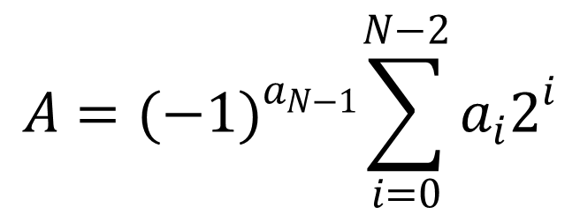
Sign/Magnitude Numbers
$A:\{a_{N−1},a_{N−2},…a_{1},a_{0}\}$
Example:
1101₂ = (-1)¹ × (1 × 2² + 0 × 2¹ + 1 × 2⁰)
= -1 × (4 + 0 + 1)
= -5
$$A={(−1)}^{a_{N−1}}\sum_{i=0}^{N−2}{a_{i}2^{i}}$$

Slide 65
Sign/Magnitude Numbers
Problems:
Addition doesn’t work, for example -6 + 6:
1110
+ 0110
10100 (wrong!)
Two representations of 0 (± 0):
1000
0000

Slide 66
Two’s Complement Numbers
Don’t have same problems as sign/magnitude numbers:
Addition works
Single representation for 0

Slide 67
Two’s Complement Numbers
Most significant bit (msb) has value of -2^{N-1}
For example, a 4-bit 2’s complement number:

Slide 68
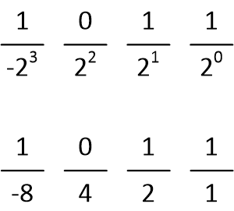
Two’s Complement Numbers
Most significant bit (msb) has value of -2^{N-1}
For example, a 4-bit 2’s complement number:
Value = -8 + 2 + 1 = -5
(We’ll show another way to find this value in a moment.)

Slide 69
Two’s Complement Numbers
msb has value of -2^{N-1}
Most positive 4-bit number:
Most negative 4-bit number:
The most significant bit still indicates the sign (1 = negative, 0 = positive)
Range of an N-bit two’s complement number:

Slide 70
Two’s Complement Numbers
msb has value of -2^{N-1}
Most positive 4-bit number: 0111
Most negative 4-bit number: 1000
The most significant bit still indicates the sign (1 = negative, 0 = positive)
Range of an N-bit two’s complement number:
[-(2^{N-1}), 2^{N-1}-1]

Slide 71
Unsigned Binary Numbers
$A:\{a_{N−1},a_{N−2},…a_{1},a_{0}\}$
Example:
1101₂ = 1 × 2³ + 1 × 2² + 0 × 2¹ + 1 × 2⁰
= 8 + 4 + 0 + 1
= 13
$$A=\sum_{i=0}^{N−1}{a_{i}2^{i}}$$

Slide 72
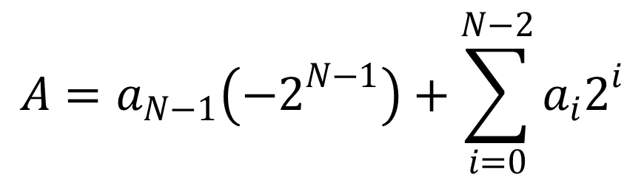
Two’s Complement Numbers
$A:\{a_{N−1},a_{N−2},…a_{1},a_{0}\}$
Example:
1101₂ = 1 × (-2³) + [ 1 × 2² + 0 × 2¹ + 1 × 2⁰ ]
= -8 + [ 4 + 0 + 1 ]
= -3
$$A=a_{N−1}\left({−2}^{N−1}\right)+\sum_{i=0}^{N−2}{a_{i}2^{i}}$$

Slide 73
“Taking the Two’s Complement”
Flips the sign of a two’s complement number.
It makes a positive number negative.
It makes a negative number positive.
Method:
Invert the bits
Add 1

Slide 74
“Taking the Two’s Complement”
Flips the sign of a two’s complement number.
Method:
Invert the bits
Add 1
Example: Flip the sign of 3₁₀ = 0011₂
1100
+ 1
1101 = -3₁₀

Slide 75
Two’s Complement Examples
Take the two’s complement of 6₁₀ = 0110₂

Slide 76
Two’s Complement Examples
Take the two’s complement of 6₁₀ = 0110₂
1001
+ 1
1010₂ = -6₁₀

Slide 77
Two’s Complement Examples
What is the decimal value of the two’s complement number 1001₂?

Slide 78
Two’s Complement Examples
What is the decimal value of the two’s complement number 1001₂?
We know it’s negative (msb = 1)
Figure out magnitude by flipping the sign (i.e., “taking the two’s complement”)
0110
+ 1
0111₂ = 7₁₀
So, we know it’s a negative number with magnitude 7.
Thus, 1001₂ = -7₁₀
Taking the two’s complement is the second (and recommended) way of figuring out the value of a negative two’s complement number.

Slide 79
Two’s Complement Addition
Add 6 + (-6) using two’s complement numbers
Add -2 + 3 using two’s complement numbers

Slide 80
Two’s Complement Addition
Add 6 + (-6) using two’s complement numbers
Add -2 + 3 using two’s complement numbers

Slide 81
Increasing Bit Width
Extend number from N to M bits (M > N) :
Sign-extension
Zero-extension

Slide 82
Sign-Extension
Sign bit copied to msb’s
Number value is same
Example 1:
4-bit representation of 3 = 0011
8-bit sign-extended value: 00000011
Example 2:
4-bit representation of -5 = 1011
8-bit sign-extended value: 11111011

Slide 83
Zero-Extension
Zeros copied to msb’s
Value changes for negative numbers
Example 1:
4-bit value = 0011 = 3₁₀
8-bit zero-extended value: 00000011 = 3₁₀
Example 2:
4-bit value = 1011 = -5₁₀
8-bit zero-extended value: 00001011 = 11₁₀

Slide 84
Number System Comparison
Number System | Range
Unsigned | [0, 2^{N}-1]
Sign/Magnitude | [-(2^{N-1}-1), 2^{N-1}-1]
Two’s Complement | [-2^{N-1}, 2^{N-1}-1]
For example, 4-bit representation:

Slide 85
George Boole, 1815-1864
Born to working class parents
Taught himself mathematics and joined the faculty of Queen’s College in Ireland
Wrote An Investigation of the Laws of Thought (1854)
Introduced binary variables
Introduced the three fundamental logic operations: AND, OR, and NOT

Slide 86
Logic Gates
Perform logic functions:
inversion (NOT), AND, OR, NAND, NOR, etc.
Single-input:
NOT gate, buffer
Two-input:
AND, OR, XOR, NAND, NOR, XNOR
Multiple-input

Slide 87
Single-Input Logic Gates

Slide 88
Single-Input Logic Gates

Slide 89
Two-Input Logic Gates

Slide 90
Two-Input Logic Gates

Slide 91
More Two-Input Logic Gates

Slide 92
More Two-Input Logic Gates

Slide 93
Multiple-Input Logic Gates

Slide 94
Multiple-Input Logic Gates
Multi-input XOR: Odd parity

Slide 95
Multiple-Input XOR
Multi-input XOR: Odd parity – the output is 1 when an odd number of inputs is 1.
Multi-input XOR: Odd parity

Slide 96
Logic Levels
Discrete voltages represent 1 and 0
For example:
0 = ground (GND) or 0 volts
1 = V_{DD} or 5 volts
What about 4.99 volts? Is that a 0 or a 1?
What about 3.2 volts?

Slide 97
Logic Levels
Range of voltages for 1 and 0
Different ranges for inputs and outputs to allow for noise

Slide 98
What is Noise?

Slide 99
What is Noise?
Anything that degrades the signal
E.g., resistance, power supply noise, coupling to neighboring wires, etc.
Example: a gate (driver) outputs 5 V but, because of resistance in a long wire, receiver gets 4.5 V

Slide 100
The Static Discipline
With logically valid inputs, every circuit element must produce logically valid outputs
Use limited ranges of voltages to represent discrete values

Slide 101
Noise Margins

Slide 102
Noise Margins
High Noise Margin: NM_{H} = V_{OH} – V_{IH}
Low Noise Margin: NM_{L} = V_{IL} – V_{OL}

Slide 103
DC Transfer Characteristics
Ideal Buffer: Real Buffer:
NM_{H} = NM_{L} = V_{DD}/2
NM_{H}, NM_{L} < V_{DD}/2

Slide 104
DC Transfer Characteristics

Slide 105
V_{DD} Scaling
In 1970’s and 1980’s, V_{DD} = 5 V
V_{DD} has dropped
Avoid frying tiny transistors
Save power
3.3 V, 2.5 V, 1.8 V, 1.5 V, 1.2 V, 1.0 V, …
Be careful connecting chips with different supply voltages

Slide 106
V_{DD} Scaling
In 1970’s and 1980’s, V_{DD} = 5 V
V_{DD} has dropped
Avoid frying tiny transistors
Save power
3.3 V, 2.5 V, 1.8 V, 1.5 V, 1.2 V, 1.0 V, …
Be careful connecting chips with different supply voltages
Chips operate because they contain magic smoke
Proof: if the magic smoke is let out, the chip stops working

Slide 107
Logic Family Examples
Logic Family | V_{DD} | V_{IL} | V_{IH} | V_{OL} | V_{OH}
TTL | 5 (4.75 - 5.25) | 0.8 | 2.0 | 0.4 | 2.4
CMOS | 5 (4.5 - 6) | 1.35 | 3.15 | 0.33 | 3.84
LVTTL | 3.3 (3 - 3.6) | 0.8 | 2.0 | 0.4 | 2.4
LVCMOS | 3.3 (3 - 3.6) | 0.9 | 1.8 | 0.36 | 2.7

Slide 108
Transistors
Logic gates built from transistors
3-ported voltage-controlled switch
2 ports connected depending on voltage of 3rd
d and s are connected (ON) when g is 1

Slide 109
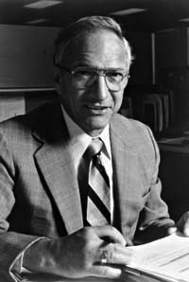
Robert Noyce, 1927-1990
Nicknamed “Mayor of Silicon Valley”
Cofounded Fairchild Semiconductor in 1957
Cofounded Intel in 1968
Co-invented the integrated circuit

Slide 110
Silicon
Transistors built from silicon, a semiconductor
Pure silicon is a poor conductor (no free charges)
Doped silicon is a good conductor (free charges)
n-type (free negative charges, electrons)
p-type (free positive charges, holes)

Slide 111
MOS Transistors
Metal oxide silicon (MOS) transistors:
Polysilicon (used to be metal) gate
Oxide (silicon dioxide) insulator
Doped silicon

Slide 112
Transistors: nMOS
Gate = 0
OFF (no connection between source and drain)
Gate = 1
ON (channel between source and drain)

Slide 113
Transistors: pMOS
pMOS transistor is opposite
ON when Gate = 0
OFF when Gate = 1

Slide 114
Transistor Function

Slide 115
Transistor Function
nMOS: pass good 0’s, so connect source to GND
pMOS: pass good 1’s, so connect source to V_{DD}

Slide 116
CMOS Gates: NOT Gate
A | P1 | N1 | Y
0
1

Slide 117
CMOS Gates: NOT Gate
A | P1 | N1 | Y
0 | ON | OFF | 1
1 | OFF | ON | 0

Slide 118
CMOS Gates: NAND Gate
A | B | P1 | P2 | N1 | N2 | Y
0 | 0
0 | 1
1 | 0
1 | 1

Slide 119
CMOS Gates: NAND Gate
A | B | P1 | P2 | N1 | N2 | Y
0 | 0 | ON | ON | OFF | OFF | 1
0 | 1 | ON | OFF | OFF | ON | 1
1 | 0 | OFF | ON | ON | OFF | 1
1 | 1 | OFF | OFF | ON | ON | 0

Slide 120
CMOS Gate Structure

Slide 121
NOR Gate
How do you build a three-input NOR gate?

Slide 122
NOR3 Gate
How do you build a three-input NOR gate?

Slide 123
Other CMOS Gates
How do you build a two-input AND gate?

Slide 124
AND2 Gate
How do you build a two-input AND gate?
CMOS is better at building inverting gates (i.e., NAND, NOR, etc.)
I.e., a 2-input NAND gate requires 2 fewer transistors than a 2-input AND gate

Slide 125
Transmission Gates
nMOS pass 1’s poorly
pMOS pass 0’s poorly
Transmission gate is a better switch
passes both 0 and 1 well
When EN = 1, the switch is ON:
EN = 0 and A is connected to B
When EN = 0, the switch is OFF:
A is not connected to B

Slide 126
Pseudo-nMOS Gates
Replace pull-up network with weak pMOS transistor that is always on
pMOS transistor: pulls output HIGH only when nMOS network not pulling it LOW

Slide 127
Pseudo-nMOS Example
Pseudo-nMOS NOR4

Slide 128
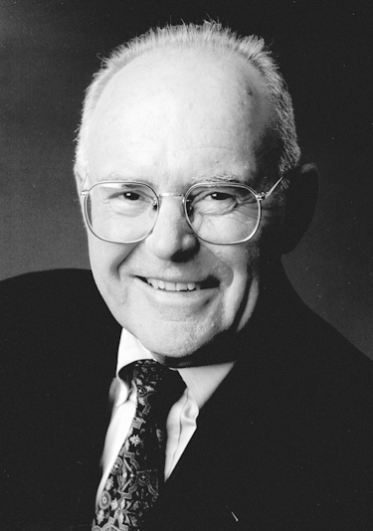
Gordon Moore, 1929-
Cofounded Intel in 1968 with Robert Noyce.
Moore’s Law: number of transistors on a computer chip doubles every year (observed in 1965)
Since 1975, transistor counts have doubled every two years.

Slide 129
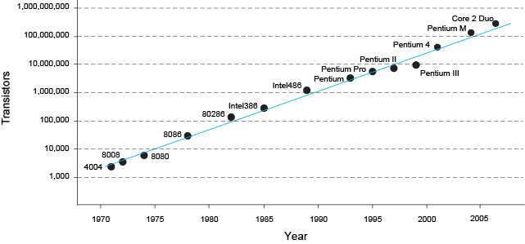
Moore’s Law
“If the automobile had followed the same development cycle as the computer, a Rolls-Royce would today cost $100, get one million miles to the gallon, and explode once a year . . .” (Robert Cringely, Infoworld)
– Robert Cringley

Slide 130
Power Consumption
Power = Energy consumed per unit time
Dynamic power consumption
Static power consumption

Slide 131
Dynamic Power Consumption
Power to charge transistor gate capacitances
Energy required to charge a capacitance, C, to V_{DD} is CV_{DD}²
Circuit running at frequency f: Transistors switch (from 1 to 0 or vice versa) at that frequency
Capacitor is charged f/2 times per second (discharging from 1 to 0 is free)
Dynamic power consumption:
P_{dynamic} = ½CV_{DD}²f

Slide 132
Static Power Consumption
Power consumed when no gates are switching
Caused by the quiescent supply current, I_{DD} (also called the leakage current)
Static power consumption:
P_{static} = I_{DD}V_{DD}

Slide 133
Total Power Consumption
Dynamic power + static power
P_{total} = P_{static} + P_{dynamic}

Slide 134
Power Consumption Example
Estimate the power consumption of a wireless handheld computer
V_{DD} = 1.2 V
C = 20 nF
f = 1 GHz
I_{DD} = 20 mA

Slide 135
Power Consumption Example
Estimate the power consumption of a wireless handheld computer
V_{DD} = 1.2 V
C = 20 nF
f = 1 GHz
I_{DD} = 20 mA
P = ½CV_{DD}²f + I_{DD}V_{DD}
= ½(20 nF)(1.2 V)²(1 GHz) + (20 mA)(1.2 V)
= (14.4 + 0.024) W ≈ 14.4 W (14.424 W to be more exact)

